Slide 1
Dynamic Pricing for EV Charging Station
Submitted By:
Saradindu Rana [ T91-CSE-186011 ]
Debopriyo Ghosh [ T91-CSE-186003 ]
Saikat Jana [ T91-CSE-186017 ]

Slide 2
Contents
Introduction & EV Charging Tariffs in Different States
Problem With Fixed Pricing & Dynamic Pricing
Advantage of Dynamic Pricing & DP In Case of EV Charging
Various Pricing Strategies
Business Model & Data Flow Diagram
Dynamic Pricing Algorithms
Conclusion
References

Slide 3
Introduction
The popularity of electric vehicles (EVs) is rising. The electric vehicle (EV) market in India is expected to hit over 63 lakh unit mark per annum by 2027 [1].
The increasing adoption of EVs will also bring a challenge for charging them hassle freely, as EV charging is more time consuming process than a traditional oil filling .
As of March 2021, 21 states and Union Territories have introduced specific tariffs for EV charging with reduced energy charges and/or demand charge exemptions[2]. Details of state EV tariffs are provided on the next slide..

Slide 4
EV Charging Tariffs in Different States
State | EV TARIFF
 | ENERGY CHARGE | DEMAND CHARGE
 |  | Low tension | High tension
Andhra Pradesh | Rs 6.7/kWh | - | -
Assam | Rs 5.25 to 6.75/kWh | Rs 130/kW per month | Rs 160/kVA per month
Bihar | Rs 6.3 to 7.4/kWh | - | -
Chhattisgarh | Rs 5/kWh | - | -
Delhi | Rs 4.5/kWh | - | -
Gujarat | Rs 4 to 4.1/kWh | - | Rs 25 to 50 per kVA per month
Haryana | Rs 6.2/kWh | Rs 100/kW per month | -
Himachal Pradesh | Rs 4.70 to Rs 5/kWh | - | Rs 130/connection per month and Rs 140/kVA per month
Jharkhand | Rs 6.00 to 6.25/kWh | Rs 40 to 150/connection per month
Karnataka | Rs 5/kWh | Rs 60/kW per month | Rs 190/kVA per month
Kerala | Rs 5/kWh | Rs 75/kW | 250/kVA per month
Madhya Pradesh | Rs 5.9 to Rs 6/kWh | - | Rs 100 to 120/kVA of billing demand
Maharashtra | Rs 4.05 to 4.24/kWh | - | Rs 70/kVA per month
Meghalaya | Rs 10.09/kWh | Rs 100 to 230/ connection per month
Odisha | Rs 4.20 to 5.70/ kWh | Rs 200 to 250/kW per month | Rs 200 to 250/kVA per month
Punjab | Rs 5.4/kWh | - | -
Rajasthan | Rs 6/kWh | Rs 40/HP per month | Rs 135/kVA per month
Tamil Nadu | Rs 5 to 8.05/kWh | Rs 70/kW per month | -
Telangana | Rs 6/kWh | - | -
Uttar Pradesh | Rs 5.9 to Rs 7.7/kWh | - | -
Uttarakhand | Rs 5.5/kWh | - | -

Slide 5
Problem with Fixed Pricing^{[4]}
Fixed pricing doesn't allow for adjustments if a consumer realizes that cost basis is higher than expected.
The customer pays the established price regardless of changes in electricity cost per unit also other factors.
Fixed pricing also doesn't allow for adjustments over time to sell off extra inventory.

Slide 6
What is dynamic pricing^{[6]}?
Businesses implement dynamic pricing as a type of price discrimination. This allows businesses to change the price of a product based on a number of variables such as the market conditions or varying components within the business. With dynamic pricing, you can change the price your business charges for a product or service to reflect differences in market conditions and seasonality. For instance, charging price may be increased in case of peak hours in the charging stations, which will indirectly decrease load on the grid.

Slide 7
Dynamic Pricing Advantages^{[6]}
Dynamic pricing means the price on a product or service can change over time.
Keeps the market competitive.
Decreases the chance of market monopoly.
Dynamic pricing allows to analyse each customer.

Slide 8
Dynamic Pricing in Case of EV Charging^{[3]}.
Dynamic pricing means, that the charging provider—which can be a distribution system operator or an operator/aggregator of charging stations—dynamically adapts the price, which has to be paid by the end users (the EV drivers) for charging their EVs.
it is possible to achieve different benefits like
Increasing the stability of the power grid.
Increasing user satisfaction.
Reducing the operating costs of public charging stations.

Slide 9
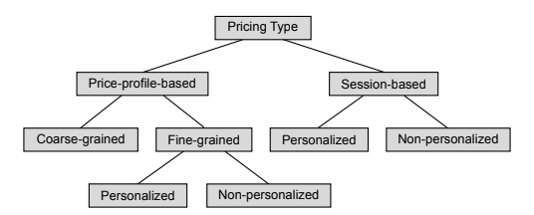
Various Pricing Strategies
Steffen Limmer[3] in his literature review has shown that the pricing strategies can be categorized according to the following figure.

Slide 10
Price-profile-based pricing sets different prices (usually per energy unit) for different time intervals.
Mostly used Price-profile-based are fine-grained price profiles, which set an individual price for each small scheduling interval which may be for 5 minutes or one hour.
However, some authors like Guo et al. [5] propose coarse-grained price profiles, which set a constant charging price for a longer time.
The fine-grained price profiles can be either personalized or non-personalized.
In session-based pricing, a user is presented with a total price for a complete charging session. Like for fine-grained price profiles, personalized and non-personalized variants of session-based pricing can also be defined.

Slide 11
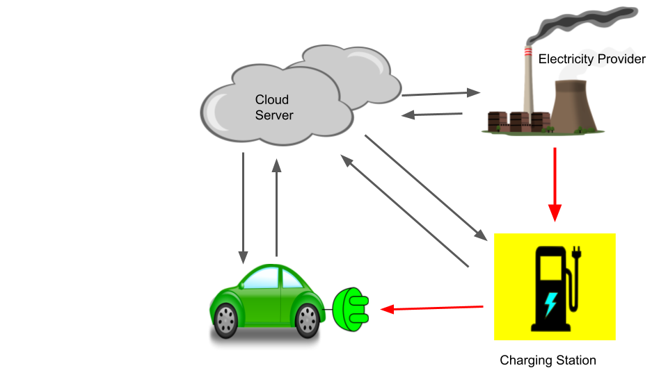
Business Model

Slide 12
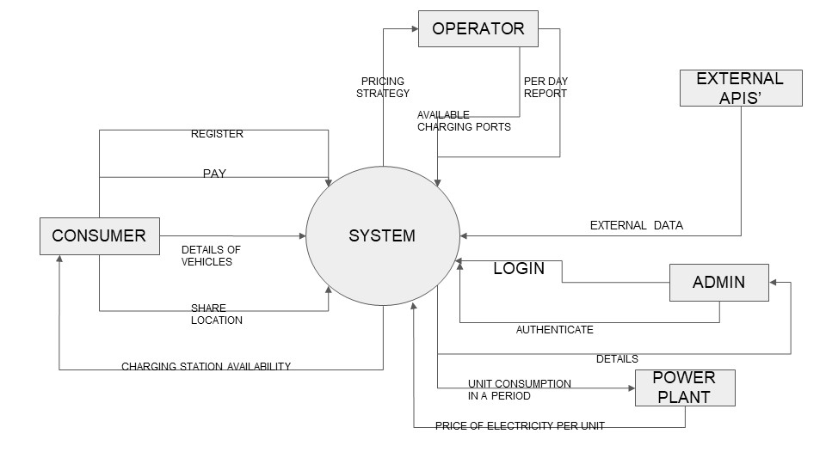
Data Flow Diagram

Slide 13
Dynamic pricing algorithms^{[6]}
Traditional, rule-based algorithms: the logic of these algorithms has been explicitly programmed. They often consist of a range of “if/then” rules that determine prices based on a range of influencing factors.
Machine learning based algorithms: these algorithms learn on a set of training data to make predictions on the price effect on sales, revenue and profit. Based on that forecast, one can run optimizations to reach business targets. This algorithm and its logic of prediction is not explicitly programmed. The algorithm continuously learns from new data.
Our Plan is to implement a Machine Learning Based Algorithm.

Slide 14
Advantage of Machine learning based algorithms^{[6]}
A limitation of traditional algorithms is that they can only consider a limited amount of influencing factors. Managing and monitoring this rule-based approach also takes a fair amount of time and effort.
In contrast,
A machine learning based approach can calculate considering a range of influencing factors, both internal as well as external.
By using machine learning based dynamic price optimization, these systems can identify narrow segments, determine what drives value for each one, and match that with historical transactional data. This allows charging stations to set optimal prices for clusters of customers and segments based on data.
Automation also makes it much easier as the pricing algorithm will learn and adapt with data over time.

Slide 15
Types of data used for dynamic pricing using ML.
Internal data including current price per unit, charging stations maintenance cost, load on that charging stations (number of EVs currently charging) etc.
Inventory level: This is essential data regarding details among current availability if the ports (existing supplies combine with existing demand), which is a key determinant in how a dynamic pricing will be calculated.
Electricity cost: Electricity cost per unit is a deciding factor.
Maintenance charges: This includes all the cost which must be spend as human resources, rent for the lands of charging stations, and also maintenance charges for the software or cloud service charges.

Slide 16
External data and influential factors that include competitor data, time-oriented data, and location specific data, review of the charging stations, etc.
Competitor Data: Competitor data can be far reaching. This data can be gathered by crawling (also called ‘scraping’) software which gathers the information from publicly available sources.
Days of the Week: Days of the week have an influence on consumer demand.
Holidays: The demand of charging may vary. On certain charging stations demand may increase, and decrease on some charging stations.
Weather and Seasonal Data: Weather can affect the demand, both as a broader pattern. For example, good weather is good for demand, while if the weather outside is bad people will stay home. Weather forecast data can therefore help in predicting demand and optimizing prices accordingly.
The dynamic pricing strategy will take these data and set prices to increase or decrease.

Slide 17
Conclusion
Dynamic pricing for EV charging is of increasing interest, since it can help to solve issues related to grid integration of EVs and to the profitable operation of public EV charging stations. There are a growing number of publications, proposing different approaches to dynamic pricing for EV charging, which address different flexibilities of users.
But dynamic pricing arises questions like how do EV drivers respond to dynamic prices in reality? Furthermore, it is not clear if a dynamic pricing scheme would be accepted by the users at all.
Although it is highly expected that Dynamic Pricing will resist the increase of Monopoly of one particular company in the market as there will be a competition factor on deciding the dynamic pricing.

Slide 18
References
Electric vehicle market in India expected to hit 63 lakh units per annum mark by 2027: IESA IBEF: December 23,2020 https://economictimes.indiatimes.com/industry/auto/auto-news/electric-vehicle-market-in-india-expected-to-hit-63-lakh-units-per-annum-mark-by-2027-iesa.
Suresh Chavhan, P.Sanjeevikumar,BaseemKhan.A Comprehensive Analysis of Electric Vehicle Charging Station Infrastructure in an Urban Area. https://aeee.in/wp-content/uploads/2020/07/2020-Dissecting-India%E2%80%99s-Electricity-Tariff-Landscape-For-EV-1.pdf
Steffen Limmer . Dynamic Pricing for Electric Vehicle Charging—A Literature Review https://www.researchgate.net/publication/335919327_Dynamic_Pricing_for_Electric_Vehicle_Charging-A_Literature_Review
Arie Shpanya, "Why Dynamic Pricing is a Must for eCommerce Retailers“ .August 16th 2014. https://econsultancy.com/why-dynamic-pricing-is-a-must-for-ecommerce-retailers/
Guo, Y.; Liu, X.; Yan, Y.; Zhang, N.; Su, W. Economic Analysis of Plug-in Electric Vehicle Parking Deck with Dynamic Pricing. In Proceedings of the 2014 IEEE PES General Meeting | Conference Exposition, National Harbor, MD, USA, 27–31 July 2014, pp. 1–5, [CrossRef] https://www.researchgate.net/publication/286738372_Economic_analysis_of_plug-in_electric_vehicle_parking_deck_with_dynamic_pricing
How dynamic pricing works: data driven price optimization . March 24, 2021. https://7learnings.com/blog/how-dynamic-pricing-works-data-driven-price-optimization/

Slide 19
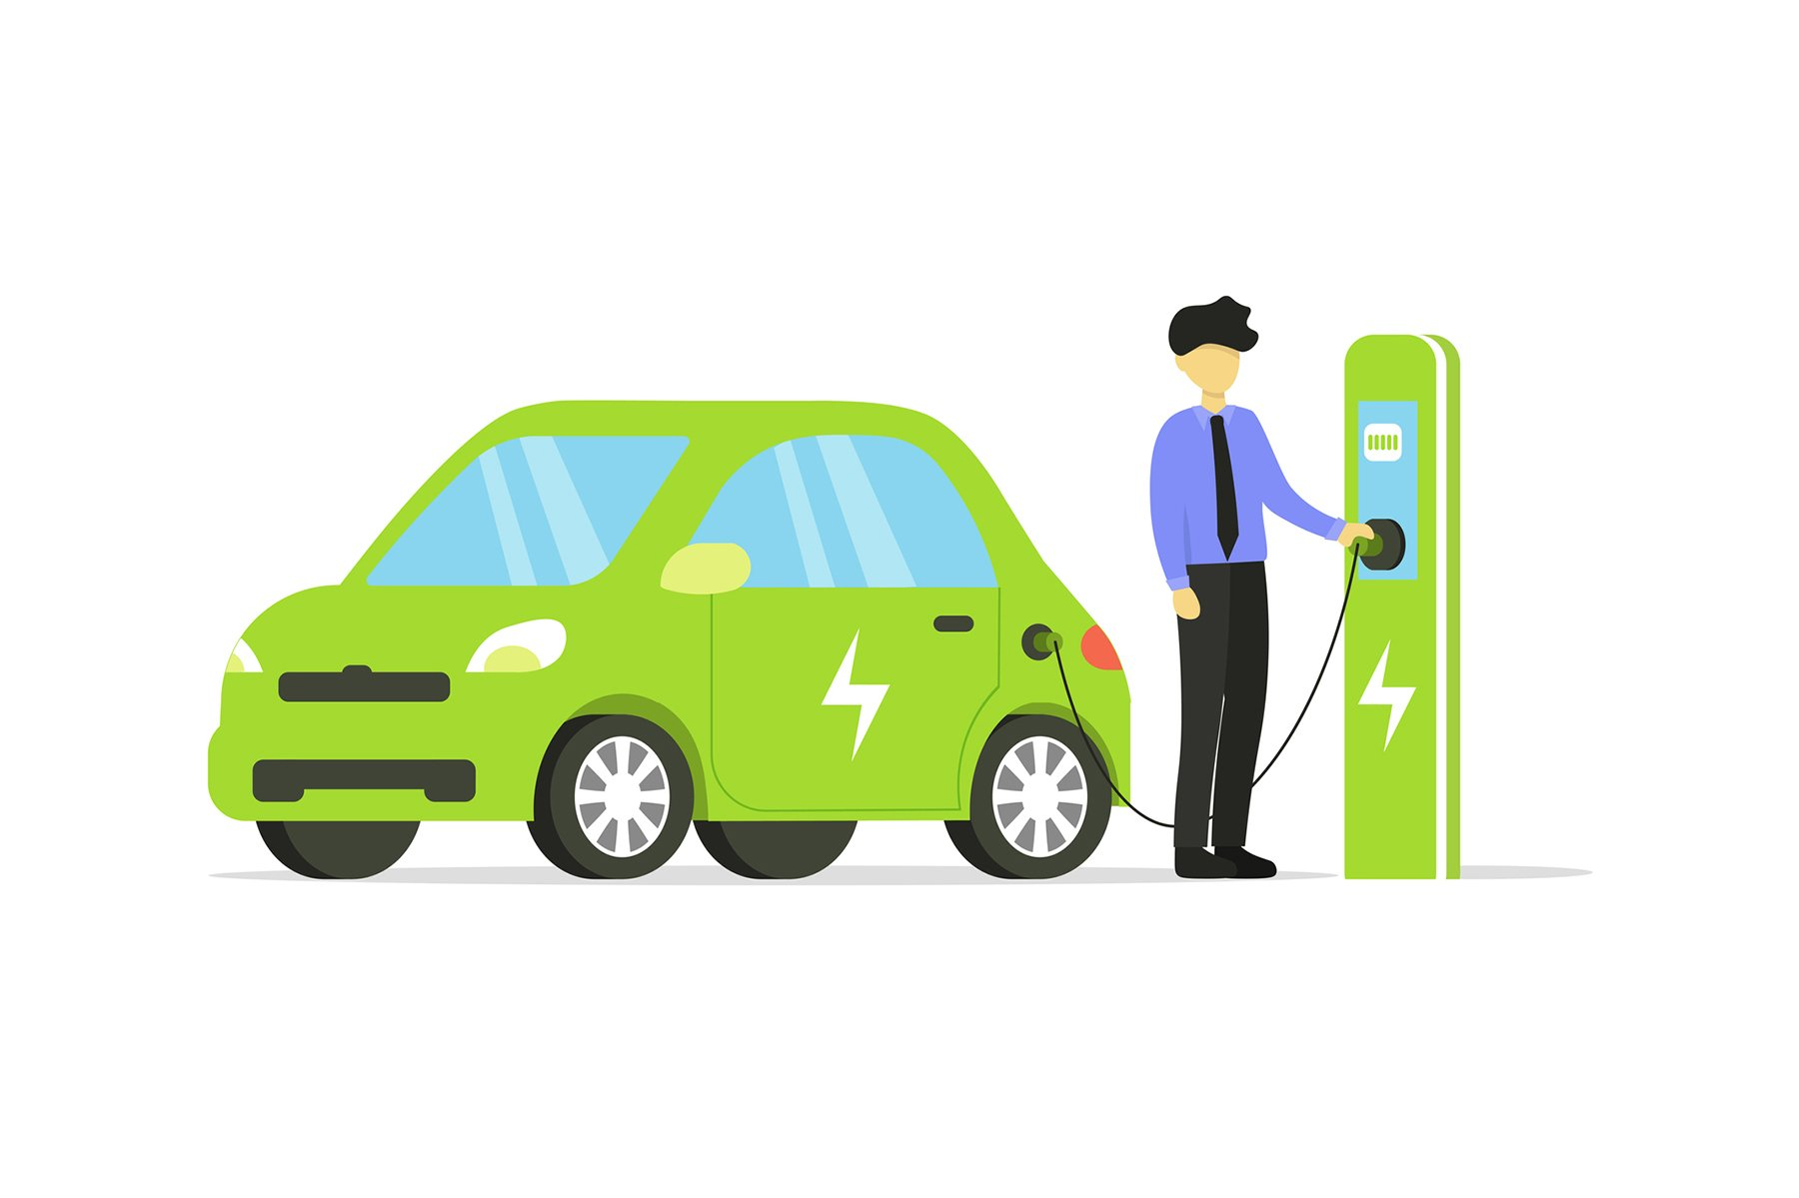
THANK YOU

